Slide 1
Advanced Concepts Java - Assignment II
BY: Rishika Kumari
1852

Slide 2
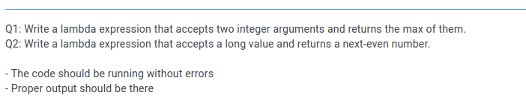

Slide 3
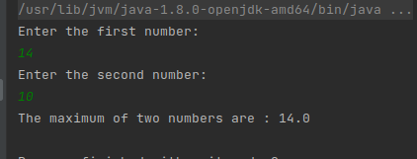
Outputs: Question 1 : 1.1

Slide 4
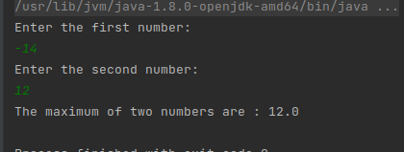
Outputs: Question 1 : 1.2

Slide 5
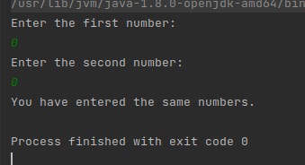
Outputs: Question 1 : 1.3

Slide 6
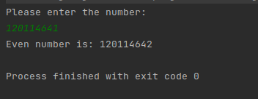
Outputs: Question 2 :

Slide 7
THANK YOU!

